Slide 1
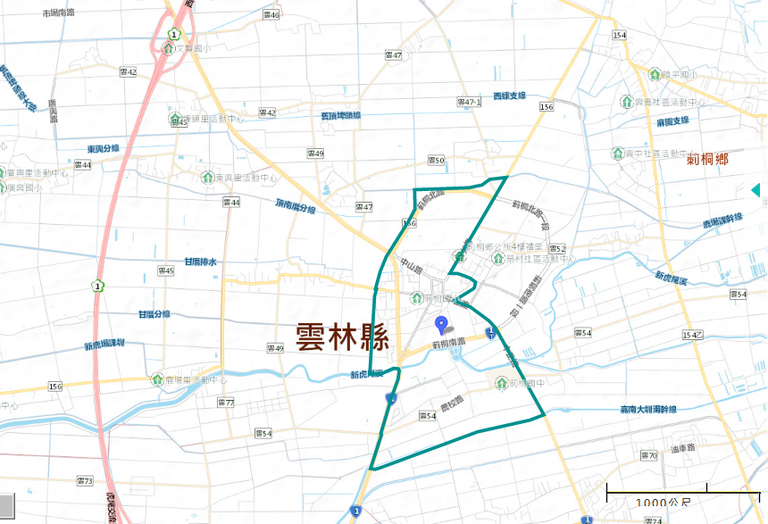
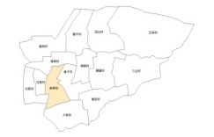
Evacuation Map of Cihtong Village, Cihtong Township, Yunlin County
Earthquake
Disaster Prevention Information
Administration Zone
Population：4,980 people
Emergency notification
CihtongTownship Emergency Operation Center,(EOC) TEL:05-584-0893
Chief of Village:CHEN,CHEN-JIAN-FEN (陳堅棻) Mobile:05-584-7636 0933-477551
Cihtong Police Office TEL: 05-584-2025
Cihtong Fire Department
TEL: 05-584-2094
Citong N. Rd
Cihtong Township Office
RONG CUN SHE CYU,HUO-DONG-JHONG-SIN
Disaster Prevention Information Website
Cihtong Primary School
Soil and Water Conservation Bureau
http://246.swcb.gov.tw/
Water Resources Agency
http://www.wra.gov.tw/
Directorate General of Highways
http://www.thb.gov.tw/
Yunlin County
Zhongzheng Rd
Cihtong Township
Yunlin County Cihtong Juniou High School
Evacuation Principle
Earthquake: Take refuge at open spaces or parks.
Evacuation Shelter
Shelter: Cihtong junior High School
Accommodate: 40 people
Address: No. 1, Nongxiao, Citong Township
TEL: 05-584-2014
Village Boundary
Evacuation Route
Indoor Evacuation Shelter
Shelter for Earthquake
Made by Cihtong Township Office, June 2024

Slide 2
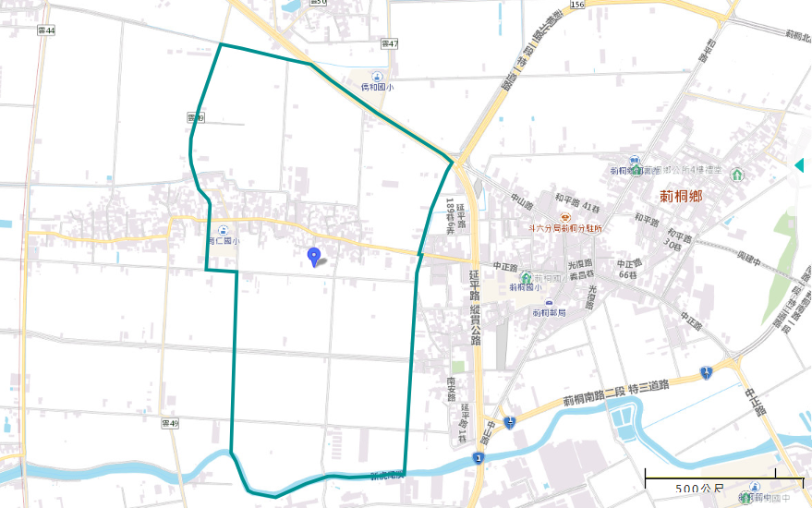
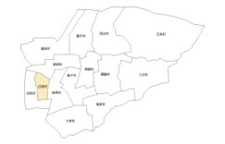
Evacuation Map of Gancuo Village, Cihtong Township, Yunlin County
Earthquake
Disaster Prevention Information
Administration Zone
Ciao He Elementary School
Population：971 people
Emergency notification
Cihtong Township Office
RONG CUN SHE CYU,HUO-DONG-JHONG-SIN
CihtongTownship Emergency Operation Center,(EOC) TEL:05-584-0893
Chief of Village JHANG,SIANG,(張向) Mobile:05-584-7636 0933-477551
Cihtong Police Office TEL: 05-584-2025
Cihtong Fire Department
TEL: 05-584-2094
Disaster Prevention Information Website
Soil and Water Conservation Bureau
http://246.swcb.gov.tw/
Water Resources Agency
http://www.wra.gov.tw/
Directorate General of Highways
http://www.thb.gov.tw/
Yanping Rd
Cihtong Primary School
Yunlin County
Gancuo Township
Evacuation Principle
Earthquake: Take refuge at open spaces or parks.
Sec. 2, Citong S. Rd
Zhongzheng Rd
莿桐國中
Evacuation Shelter
Yunlin County Cihtong Juniou High School
Shelter: Cihtong junior High School
Accommodate: 40 people
Address: No. 1, Nongxiao, Citong Township
TEL: 05-584-2014
Village Boundary
Evacuation Route
Indoor Evacuation Shelter
Shelter for Earthquake
Made by Cihtong Township Office, June 2024

Slide 3
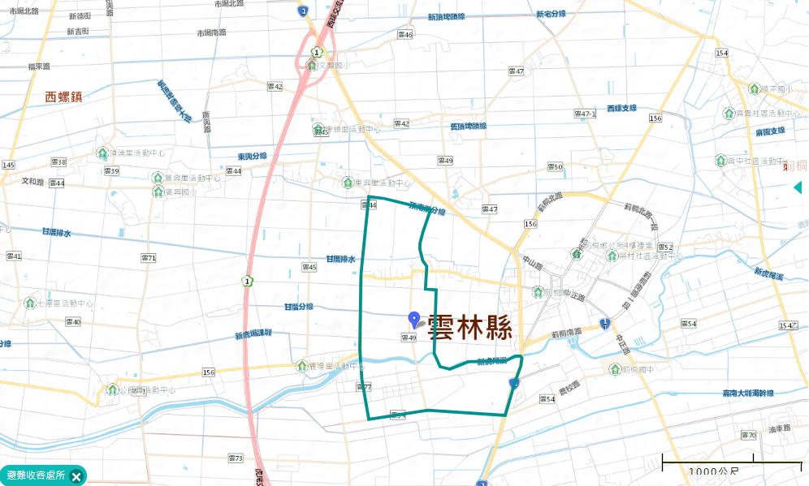
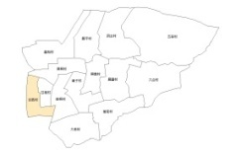
Evacuation Map of Ganxi Village, Cihtong Township, Yunlin County
Earthquake
Disaster Prevention Information
Administration Zone
Population：1,673 people
Emergency notification
CihtongTownship Emergency Operation Center,(EOC) TEL:05-584-0893
Chief of Village: LIN,JIAN-SYU,(林建旭) Mobile:05-584-4132 0937-266425
Cihtong Police Office TEL: 05-584-2025
Cihtong Fire Department
TEL: 05-584-2094
Cihtong Township Office
Disaster Prevention Information Website
RONG CUN SHE CYU,HUO-DONG-JHONG-SIN
Soil and Water Conservation Bureau
http://246.swcb.gov.tw/
Water Resources Agency
http://www.wra.gov.tw/
Directorate General of Highways
http://www.thb.gov.tw/
Ganxi Township
Zhongzheng Rd
Evacuation Principle
Yunlin County
Earthquake: Take refuge at open spaces or parks.
Yunlin County Cihtong Juniou High School
Evacuation Shelter
Shelter: Cihtong junior High School
Accommodate: 40 people
Address: No. 1, Nongxiao, Citong Township
TEL: 05-584-2014
Village Boundary
Evacuation Route
Indoor Evacuation Shelter
Shelter for Earthquake
Made by Cihtong Township Office, June 2024

Slide 4
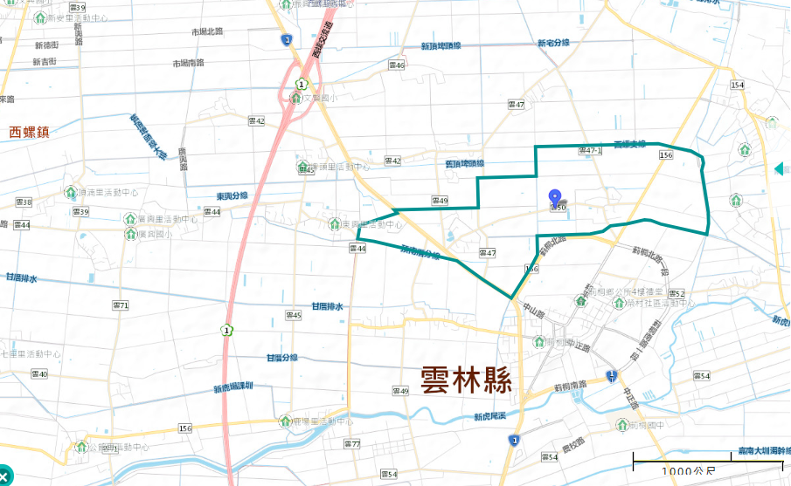
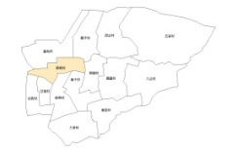
Evacuation Map of SING,TONG Village, Cihtong Township, Yunlin County
Earthquake
Disaster Prevention Information
Administration Zone
Population：1,222people
Emergency notification
CihtongTownship Emergency Operation Center,(EOC)TEL:05-584-0893
Chief of Village: LIN,CING-CONG,(林慶聰) Mobile:05-584-1365
0937-596040
Mobile:05-584-7636 0933-477551
Cihtong Police Office TEL: 05-584-2025
Cihtong Fire Department
TEL: 05-584-2094
興 桐 村
Heping Rd
Disaster Prevention Information Website
Soil and Water Conservation Bureau
http://246.swcb.gov.tw/
Water Resources Agency
http://www.wra.gov.tw/
Directorate General of Highways
http://www.thb.gov.tw/
Cihtong Township Office
Zhongzheng Rd
RONG CUN SHE CYU,HUO-DONG-JHONG-SIN
Yunlin County
Evacuation Principle
Zhongzheng Rd
Earthquake: Take refuge at open spaces or parks.
Yunlin County Cihtong Juniou High School
莿桐國中
Evacuation Shelter
Shelter: Cihtong junior High School
Accommodate: 40 people
Address: No. 1, Nongxiao, Citong Township
TEL: 05-584-2014
Village Boundary
Evacuation Route
Indoor Evacuation Shelter
Shelter for Earthquake
Made by Cihtong Township Office, June 2024

