Slide 1
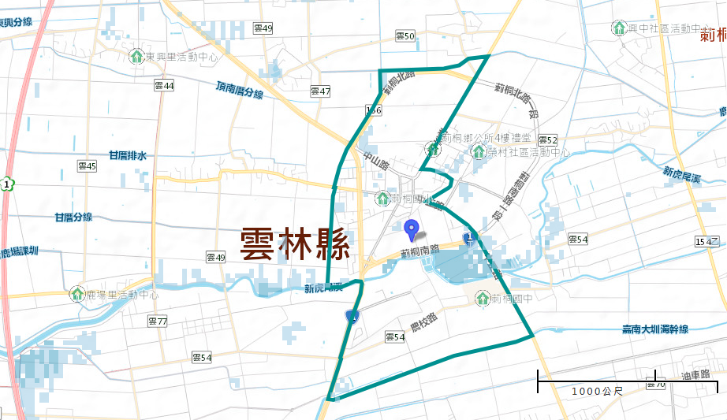
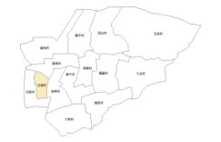
Evacuation Map of Cihtong Village, Cihtong Township, Yunlin County
Floods
Disaster Prevention Information
Administration Zone
Population：4,980 people
Emergency notification
Cihtong Township Office
CihtongTownship Emergency Operation Center,(EOC) TEL:05-584-0893
Chief of Village:CHEN,CHEN-JIAN-FEN (陳堅棻) Mobile:05-584-7636 0933-477551
Cihtong Police Office TEL: 05-584-2025
Cihtong Fire Department TEL: 05-584-2094
RONG CUN SHE CYU,HUO-DONG-JHONG-SIN
Disaster Prevention Information Website
Cihtong Primary School
Soil and Water Conservation Bureau
http://246.swcb.gov.tw/
Water Resources Agency
http://www.wra.gov.tw/
Directorate General of Highways
http://www.thb.gov.tw/
Yunlin County
Zhongzheng Rd
Cihtong Township
Yunlin County Cihtong Juniou High School
Evacuation Principle
Floods: Vertical refuge. People live in lowlands go to shelters.
Evacuation Shelter
Shelter: Cihtong junior High School
Accommodate: 40 people
Address: No. 1, Nongxiao, Citong Township
TEL: 05-584-2014
Shelter: Cihtong Primary School
Accommodate: 119 people
Address: No. 147, Zhongzheng Rd., Citong Township
TEL: 05-584-2065
Village Boundary
Evacuation Route
Indoor Evacuation Shelter
0.5-1.0 m
1.0-2.0 m
2.0-3.0 m
>3.0 m
Shelter for Flood
Emergency Operation Center, EOC
Made by Cihtong Township Office, June 2024

Slide 2
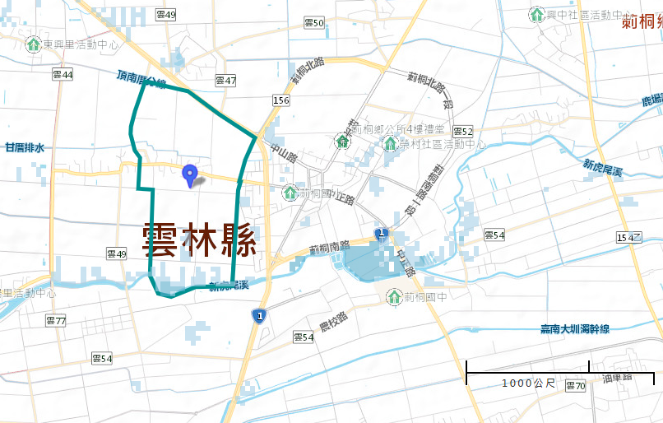
Evacuation Map of Gancuo Village, Cihtong Township, Yunlin County
Floods
Disaster Prevention Information
Administration Zone
Population：971 people
Emergency notification
Cihtong Township Office
Cihtong Township Emergency Operation Center,(EOC) TEL:05-5840893
Chief of Village JHANG,SIANG,(張向) Mobile:05-584-5023 0937-435566
Cihtong Police Office TEL: 05-584-2025
Cihtong Fire Department TEL: 05-584-2094
Gancuo Township
RONG CUN SHE CYU,HUO-DONG-JHONG-SIN
Disaster Prevention Information Website
Cihtong Primary School
Soil and Water Conservation Bureau
http://246.swcb.gov.tw/
Water Resources Agency
http://www.wra.gov.tw/
Directorate General of Highways
http://www.thb.gov.tw/
Zhongzheng Rd
Yunlin County
Yunlin County Cihtong Juniou High School
Evacuation Principle
Floods: Vertical refuge. People live in lowlands go to shelters.
Evacuation Shelter
Shelter: Cihtong Primary School
Accommodate: 119 people
Address: No. 147, Zhongzheng Rd., Citong Township
TEL: 05-584-2065
Village Boundary
Evacuation Route
Indoor Evacuation Shelter
0.5-1.0 m
1.0-2.0 m
2.0-3.0 m
>3.0 m
Shelter for Flood
Emergency Operation Center, EOC
Made by Cihtong Township Office, June 2024

Slide 3
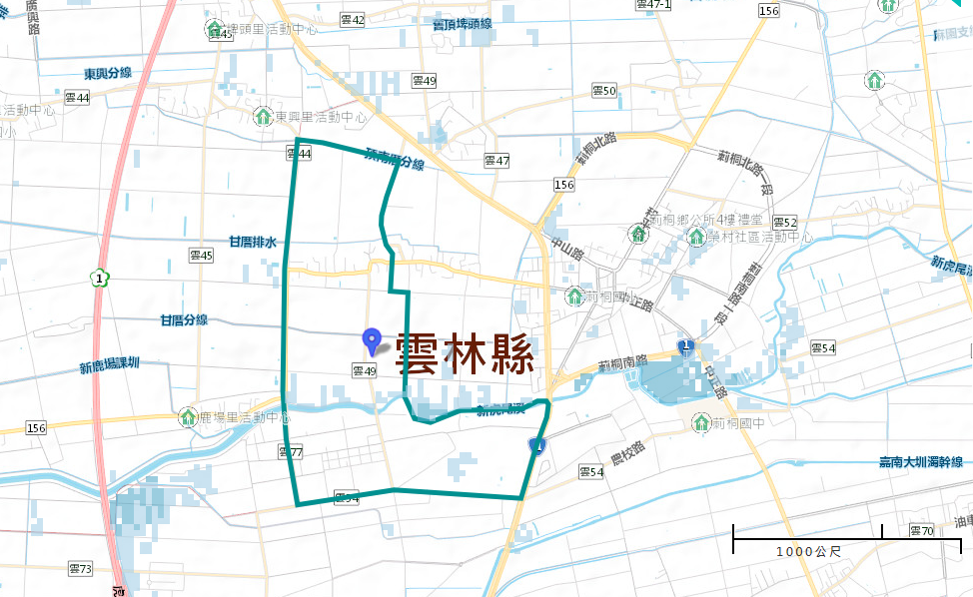
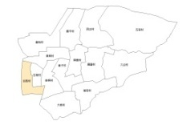
Evacuation Map of Ganxi Village, Cihtong Township, Yunlin County
Floods
Disaster Prevention Information
Administration Zone
Population：1,673people
Cihtong Township Office
Emergency notification
Heping Rd
Cihtong Township Emergency Operation Center,(EOC) TEL:05-5840893
Chief of Village: LIN,JIAN-SYU,(林建旭) Mobile:05-584-4132 0937-266425
Cihtong Police Office TEL: 05-584-2025
Cihtong Fire Department TEL: 05-584-2094
RONG CUN SHE CYU,HUO-DONG-JHONG-SIN
Cihtong Primary School
Disaster Prevention Information Website
Soil and Water Conservation Bureau
http://246.swcb.gov.tw/
Water Resources Agency
http://www.wra.gov.tw/
Directorate General of Highways
http://www.thb.gov.tw/
Zhongzheng Rd
Ganxi Township
Cihtong S. Rd
Yunlin County
Yunlin County Cihtong Juniou High School
Evacuation Principle
Floods: Vertical refuge. People live in lowlands go to shelters.
Evacuation Shelter
Shelter: Cihtong Primary School
Accommodate: 119 people
Address: No. 147, Zhongzheng Rd., Citong Township
TEL: 05-584-2065
Village Boundary
Evacuation Route
Indoor Evacuation Shelter
0.5-1.0 m
1.0-2.0 m
2.0-3.0 m
>3.0 m
Shelter for Flood
Emergency Operation Center, EOC
Made by Cihtong Township Office, June 2024

Slide 4
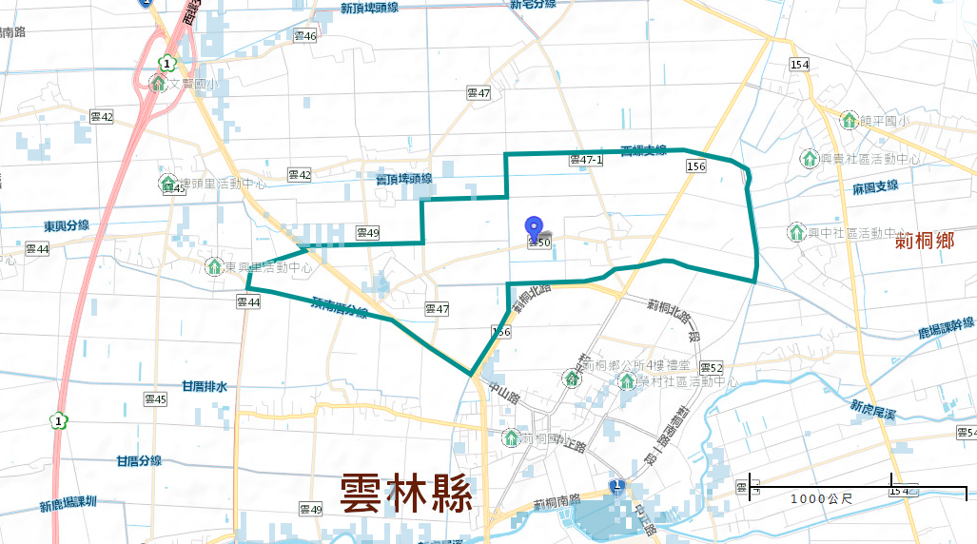
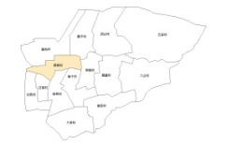
Evacuation Map of SING,TONG Village, Cihtong Township, Yunlin County
Floods
Disaster Prevention Information
Administration Zone
Population：1,222 people
SING,TONG Village
Emergency notification
Cihtong Township Emergency Operation Center,(EOC) TEL:05-5840893
Chief of Village: LIN,CING-CONG,(林慶聰) Mobile:05-584-1365
0937-596040
Cihtong Police Office TEL: 05-584-2025
Cihtong Fire Department TEL: 05-584-2094
興 桐 村
Heping Rd
Disaster Prevention Information Website
Soil and Water Conservation Bureau
http://246.swcb.gov.tw/
Water Resources Agency
http://www.wra.gov.tw/
Directorate General of Highways
http://www.thb.gov.tw/
Zhongshan Rd
Cihtong Township Office
Zhongzheng Rd
RONG CUN SHE CYU,HUO-DONG-JHONG-SIN
Evacuation Principle
Yunlin County
Floods: Vertical refuge. People live in lowlands go to shelters.
Cihtong Primary School
Evacuation Shelter
Cihtong S. Rd
Shelter: Cihtong Township Office
Accommodate: 25people
Address: No. 53, Heping Rd., Citong Township, Yunlin County Township
TEL: 05-584-4661
Shelter: Cihtong Primary School
Accommodate: 119 people
Address: No. 147, Zhongzheng Rd., Citong Township
TEL: 05-584-2065
Village Boundary
Evacuation Route
Indoor Evacuation Shelter
0.5-1.0 m
1.0-2.0 m
2.0-3.0 m
>3.0 m
Shelter for Flood
Emergency Operation Center, EOC
Made by Cihtong Township Office, June 2024

